Slide 1
MEDB 5510 Clinical Research Methods
Week 2 – Part 2
Research Ethics

Slide 2
Research Ethics
2
Basic sources of research ethics
Professional codes
Government regulations
Institutional policies
Personal convictions and responsibility
Mentors

Slide 3
Research Ethics
3
Integrity of the researcher
“The buck stops here”
Protection of human rights in clinical research
Guiding Principles (Belmont Report)
Autonomy of each individual
Beneficence
Justice
Use of control groups

Slide 4
Research Ethics
4
Central issues in research ethics
Informed consent
Privacy and confidentiality
Anonymity
Deception
Risk of harm
Exploitation
Vulnerable populations

Slide 5
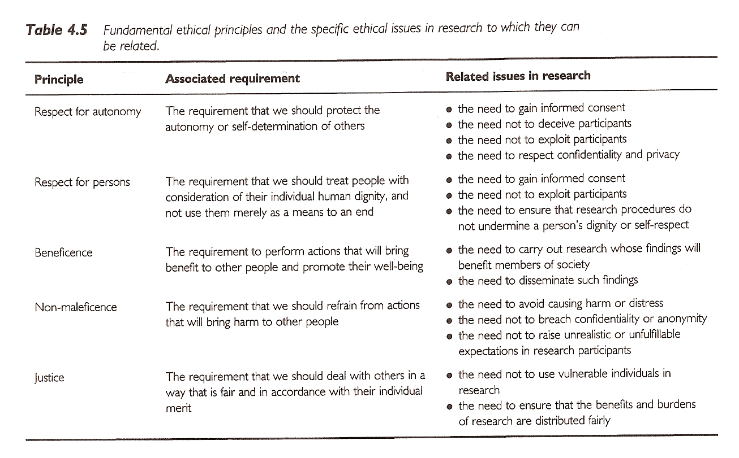
Research Ethics
Sim & Wright. Research in Health Care. 2000.
5

Slide 6
Research Ethics
6
Institutional Review Board
Purpose
Composition
Responsibilities
Elements of Informed Consent
Information elements
Consent elements
Authorization

Slide 7
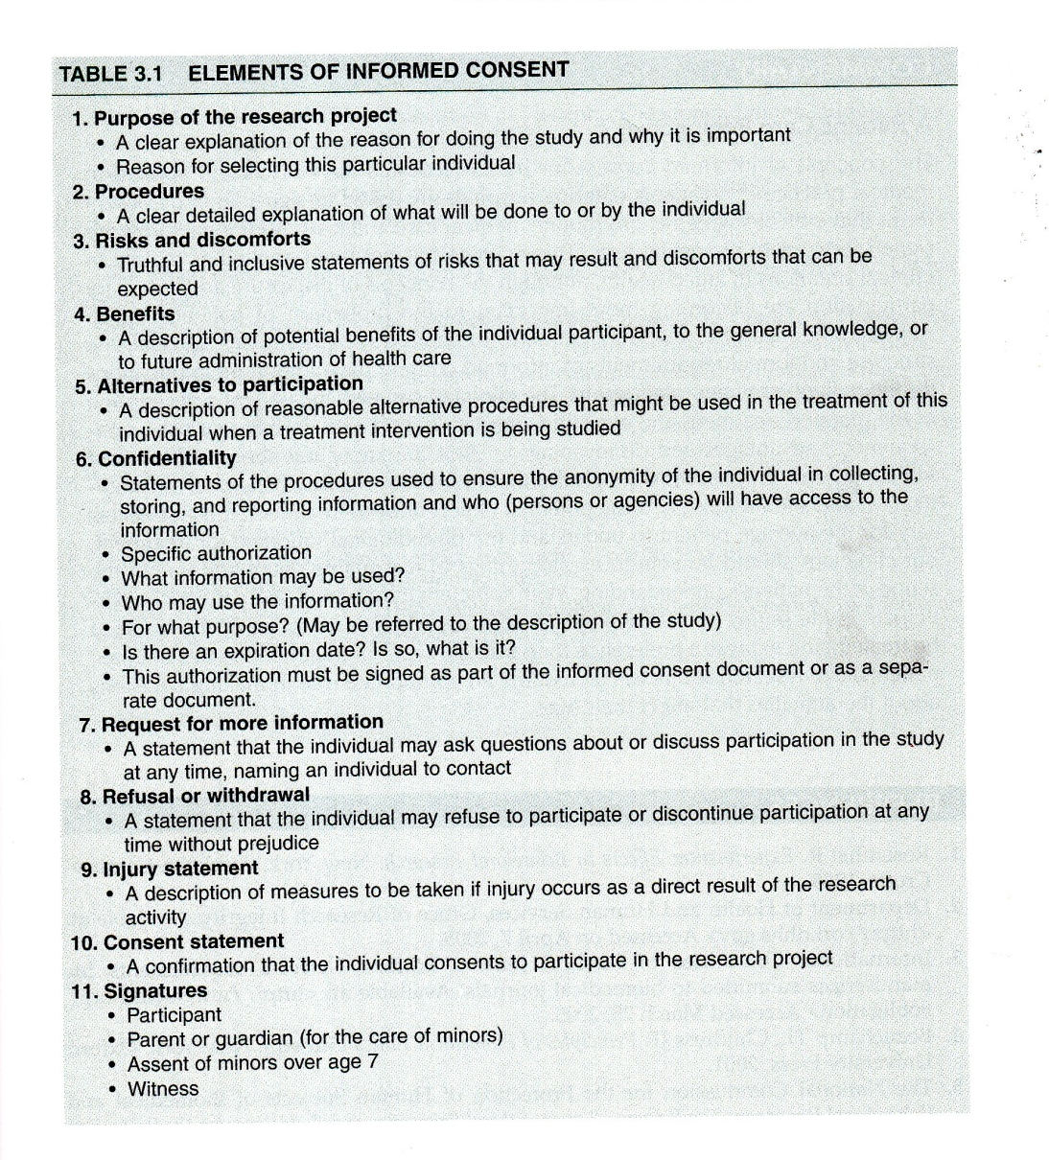
Research Ethics
Portney & Watkins, 2009.
7

Slide 8
Research Ethics
8
Other research ethics issues
Scientific misconduct
Conflict of interest
Reporting research results
Plagiarism
Duplication
Fragmentation
Authorship
Use of animals in research

Slide 9
Research Ethics
9
NIH definition (NIH Catalyst, 2001)
Scientific/research misconduct is –
Fabrication – inventing data or results
Falsification – manipulating research materials, equipment, or processes, or changing or omitting data or results
Plagiarism – appropriation of ideas, processes, results, or words of another person without giving appropriate credit

Slide 10
Research Ethics
10
Training –
CITI training – used by multiple institutions
IRBs –
UMKC IRB
IRBs at other institutions (CMH, St. Luke’s …)
Research committees –

Slide 11
Assignment #1
11
Complete the UMKC IRB training.
Get to this from the UMKC Research Support page
http://www.umkc.edu/ors/irb/training.cfm
http://www.citiprogram.org/
Select “Group 1 – Biomedical Investigator”
Send a copy of the Certificate of Completion to Dr. Gerkovich (gerkovichm@umkc.edu); this copy will be kept by me so make sure to also print out a copy for your own file.

